Slide 1
id of last inserted record
Week 10

Slide 2
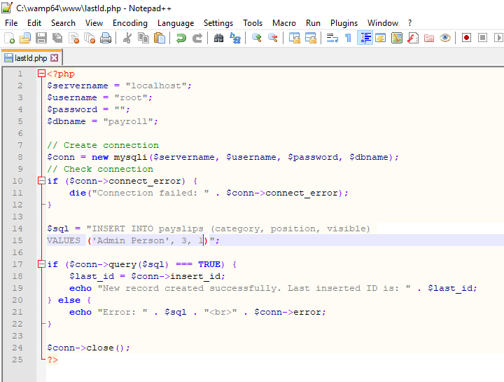

Slide 3

